Slide 1
Introduction to Copilot Development
Creating our first Copilot in Business Central

Slide 2


Your Speaker
Marcel Chabot
Software Development Practice Manager
A life-long software developer and “maker”, Marcel brings experience and a unique approach to complex problems and solutions in D365

Slide 3
Session Agenda
Create AI Capacity
  Create Azure AI Resource
  Configure resource
Develop Business Central AL Code
  Securely store AI Credentials
  Create user interface
  Interact with AI processor
Talk about prompt management
  System prompt
  User prompt

Slide 4
Create Azure Resource

Slide 5
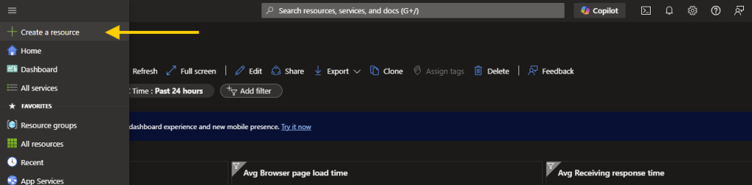
Azure Portal

Slide 6
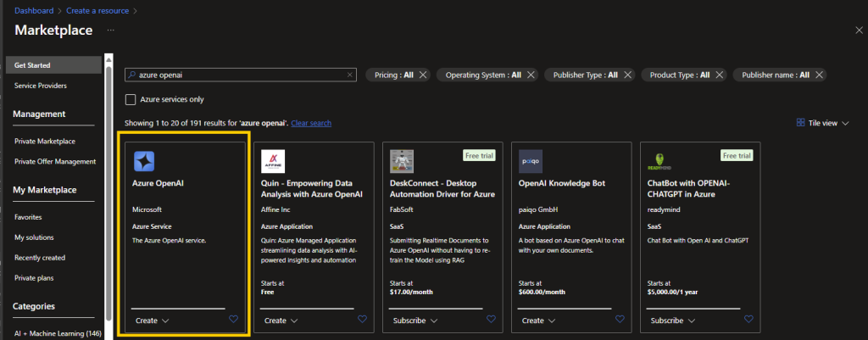
Azure OpenAI
Notes:
You are going to need some Azure Subscription. A pay as you go is a good start.

Slide 7
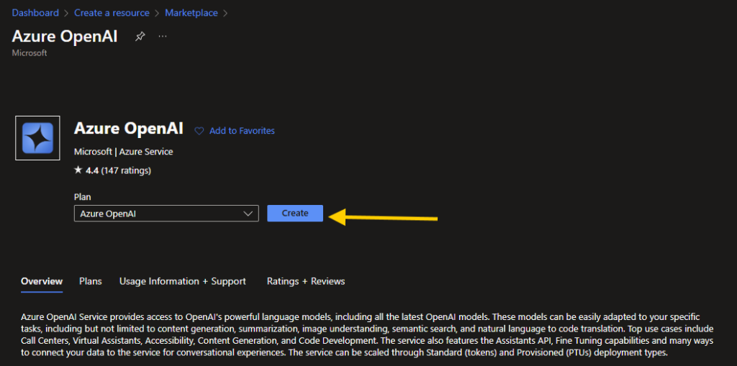

Slide 8
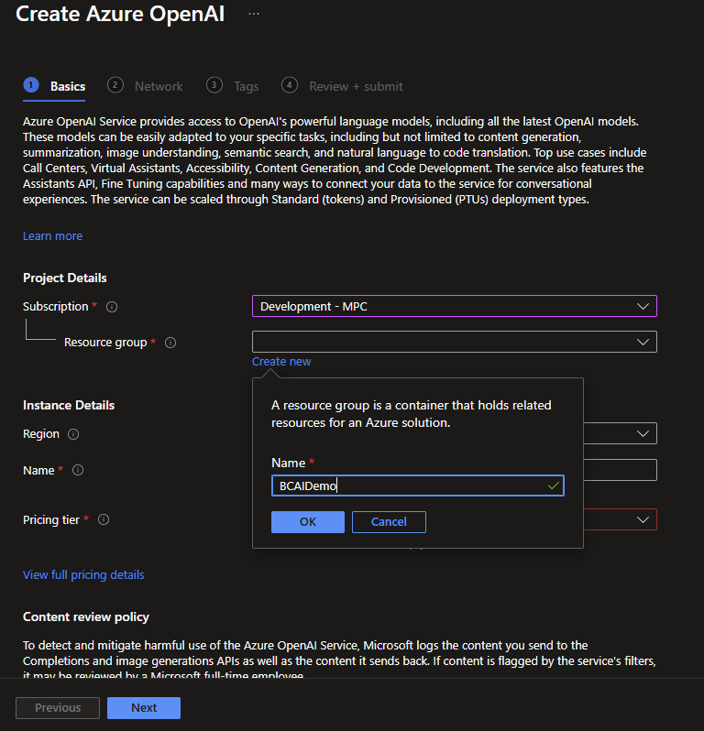
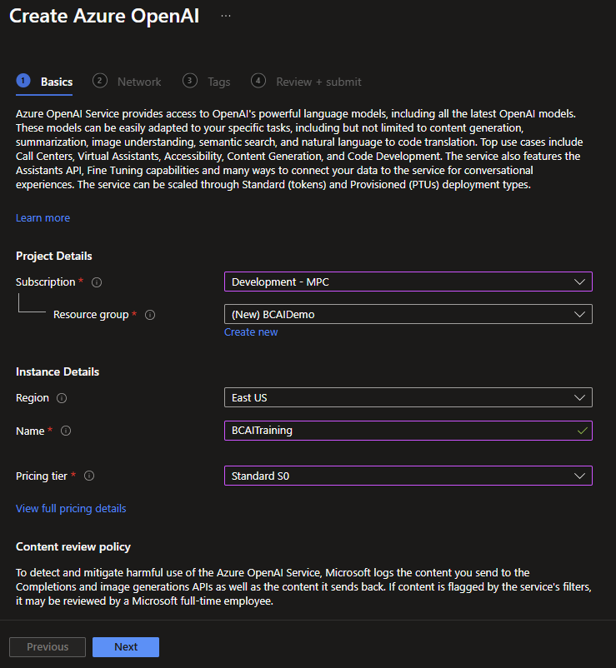

Slide 9
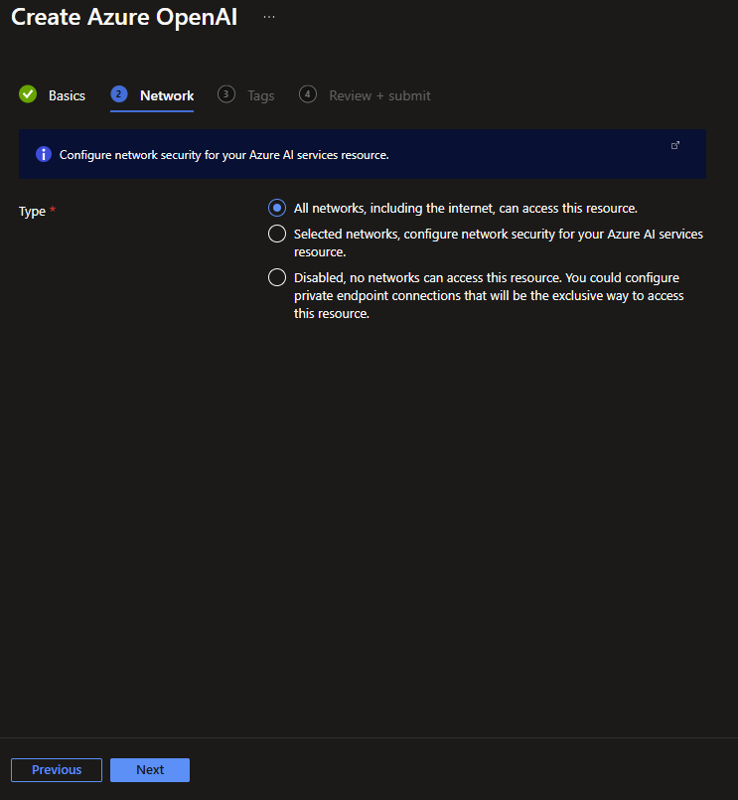
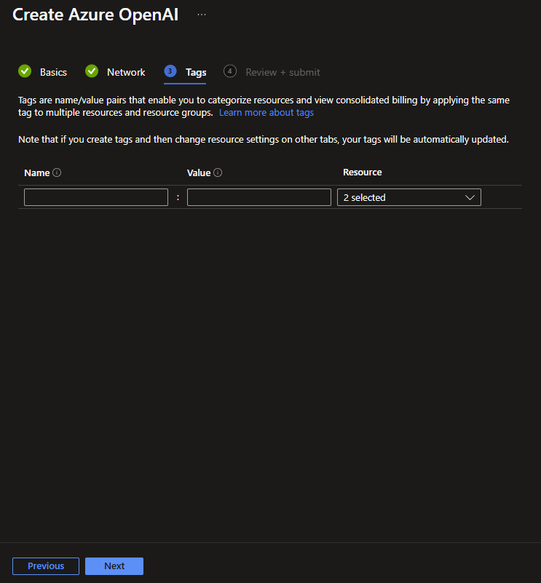

Slide 10
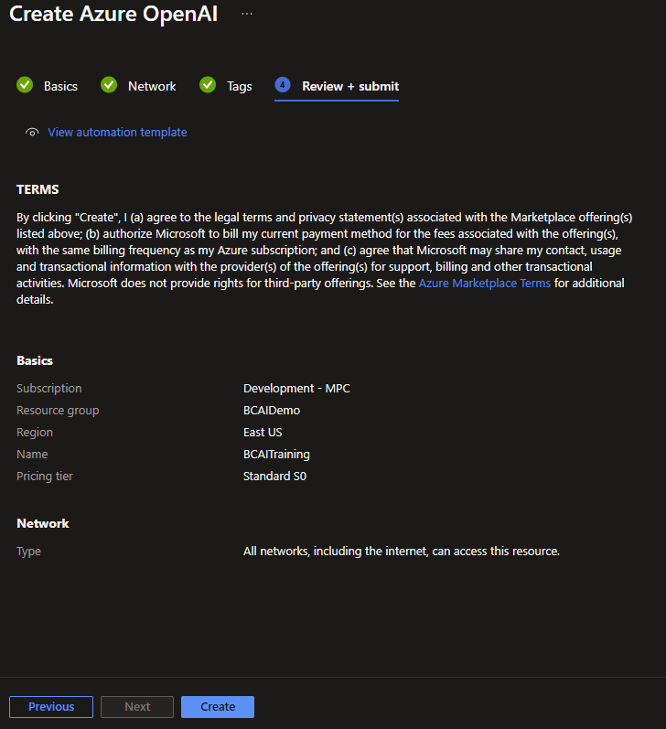
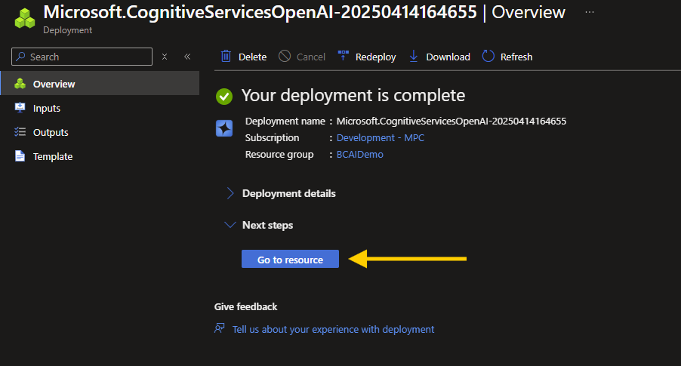

Slide 11
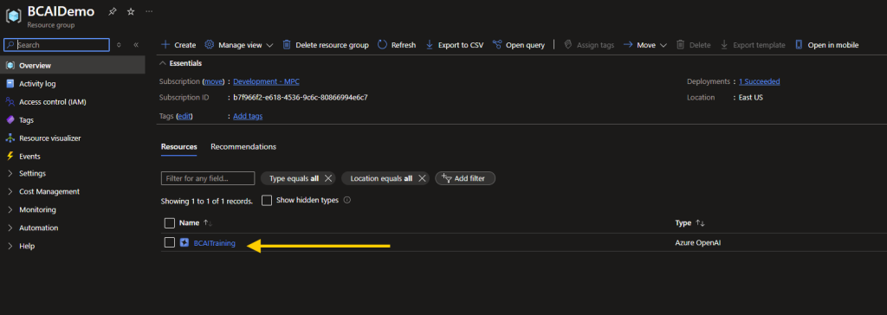

Slide 12
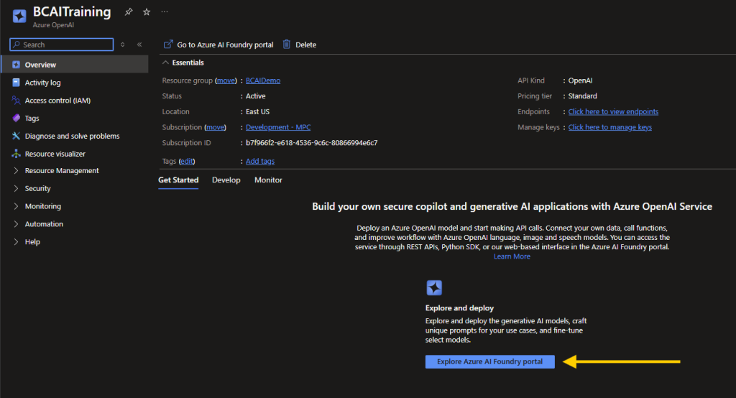

Slide 13
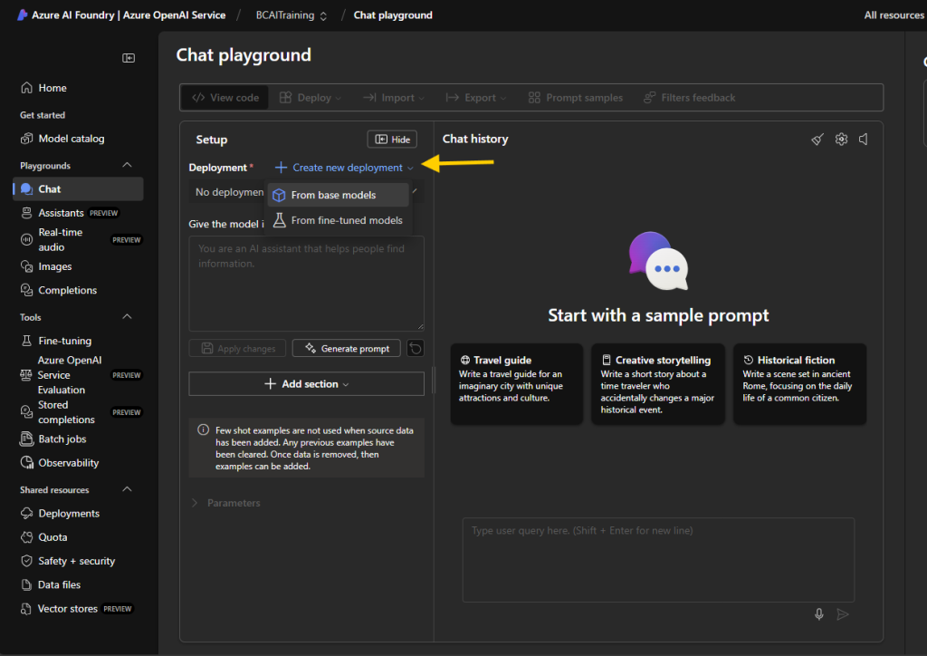

Slide 14
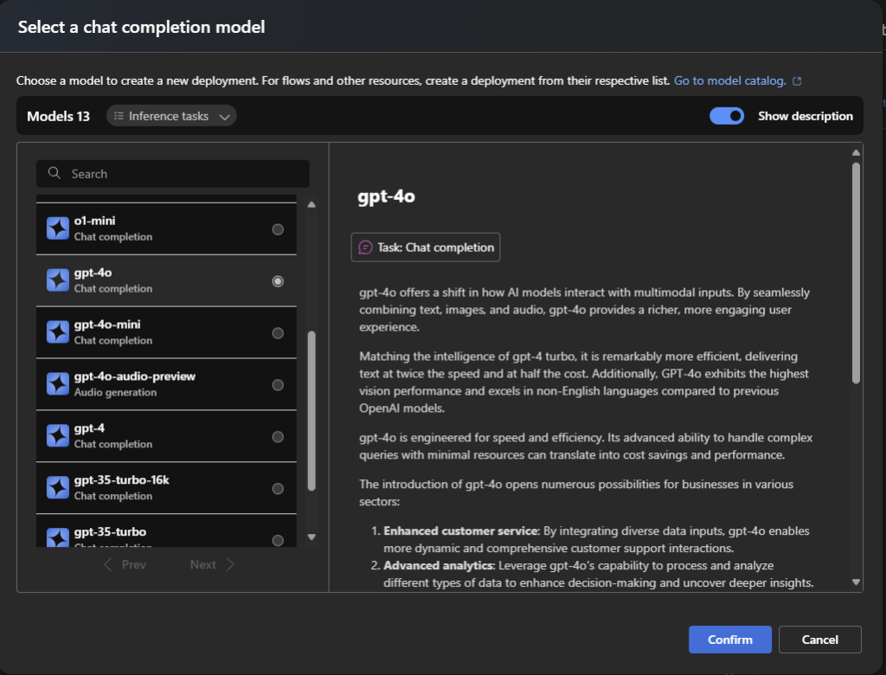

Slide 15
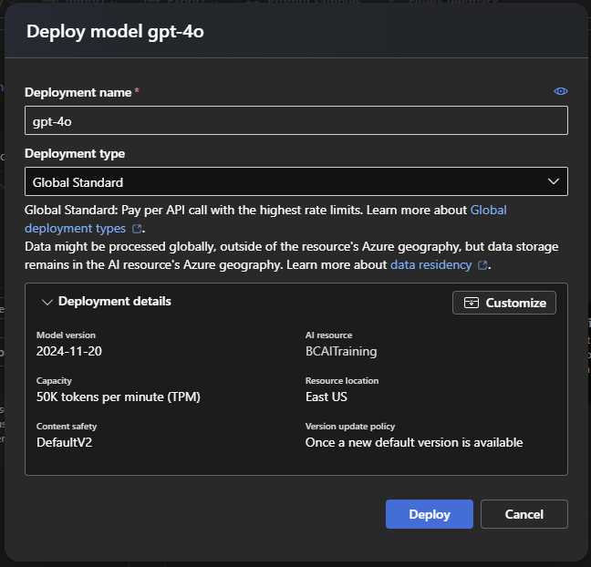

Slide 16
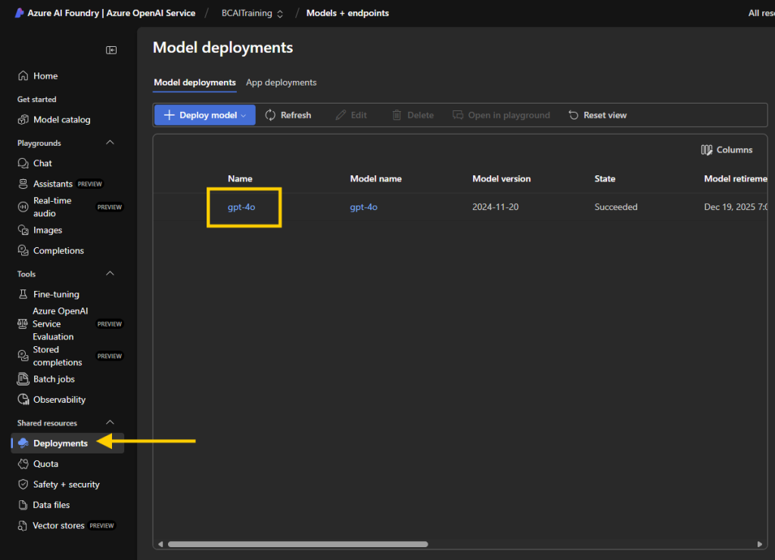

Slide 17
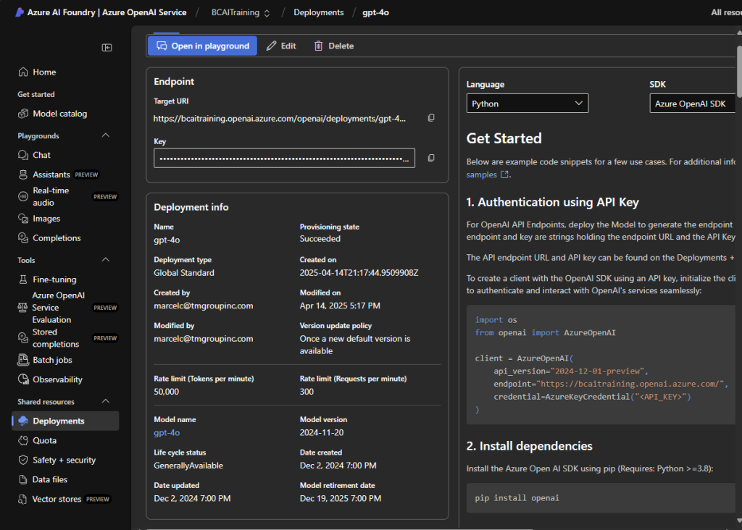

Slide 18
AL Code
Done with Azure, on to the Code!

Slide 19
Copilot Best Practices

Slide 20
Do’s and Don’ts
Keep user informed when AI is in use.
Don’t act without permission.
Allow users to review ALL actions.

Slide 21
Prompt Management

Slide 22
System Prompts
Configures the GPT system as to it’s expectations.
Define the roll as if it was a person.
  Define as a storyteller for creative answers.
  Define as an engineer for math.
Define output rules.
  As JSON with a template.
This highly impacts the output expectations.

Slide 23
User Prompt
Represents the working data for the GPT system.
Can be embellished with additional data from the system.
  Data from the sourcing record.
The user should be guided to enter good data.

Slide 24
Cost Management
Tokens = Money
  4 characters ish
  ¾ of a word
  100 tokens = 75 words
Don’t lose your API key!

Slide 25
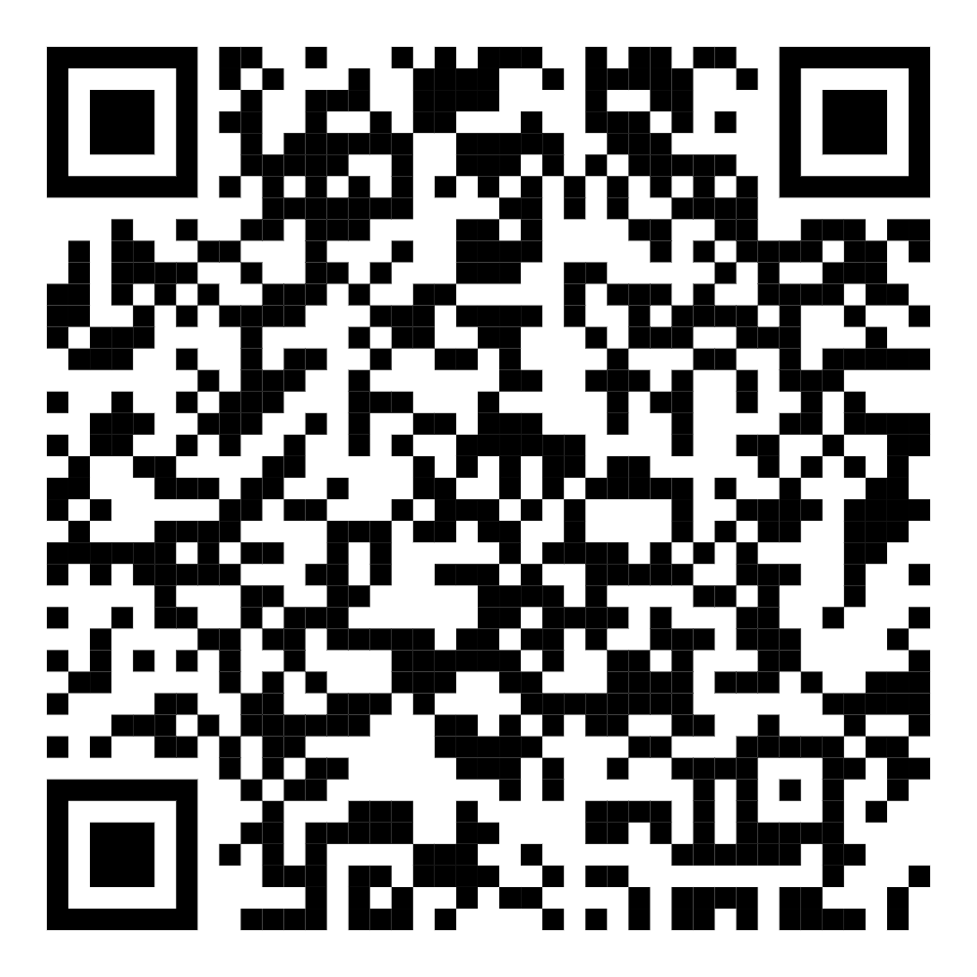
Thank You!
Marcel Chabot
Software Development Practice Manager
The TM Group, Inc.
Mad Scientist
AardvarkLab.Blog

Slide 27
Title slide

